Slide 1
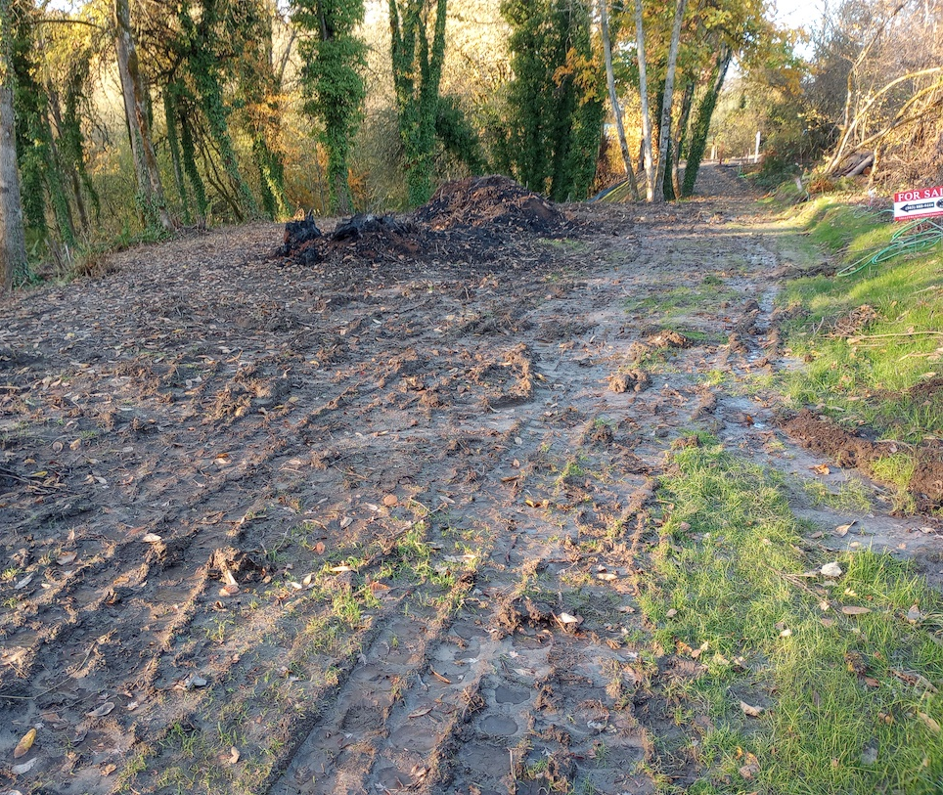
This burn was in fact prohibited, and no permit was issued.
Confirmed by DEQ
OAR 340-264-0110

Slide 2
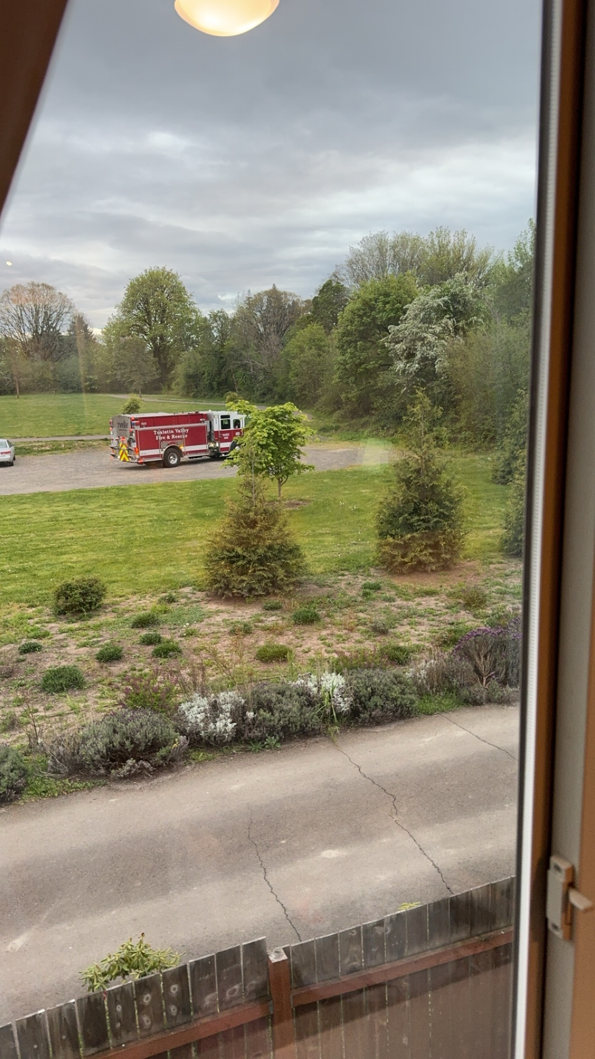
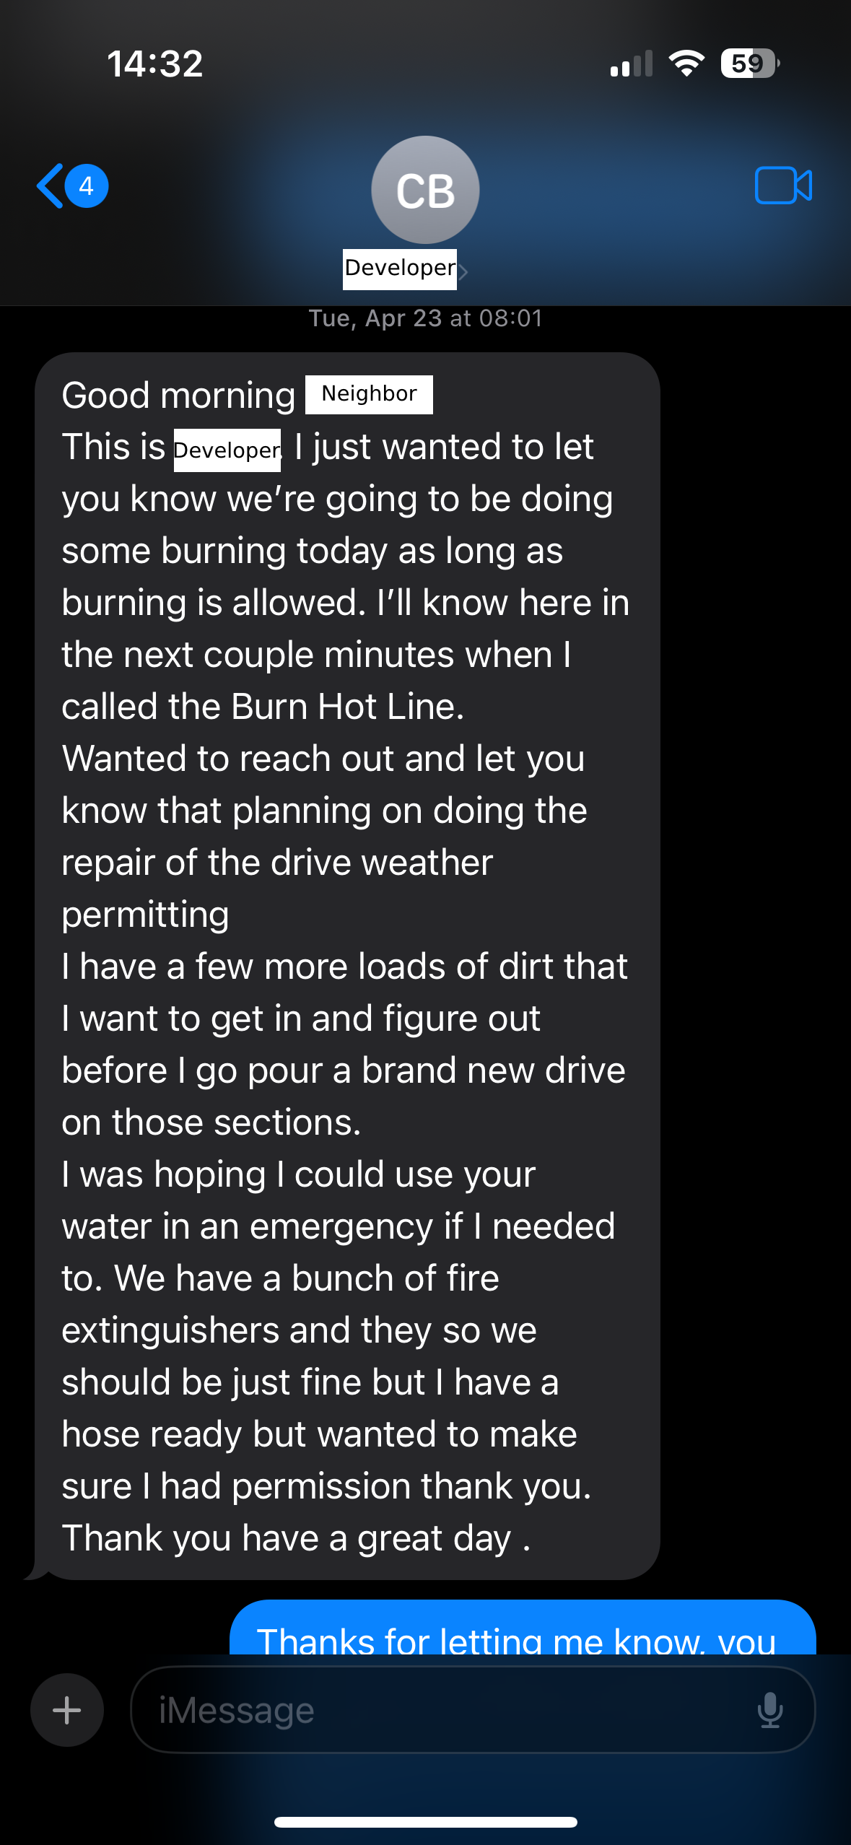
Despite no permit, the burn was carried out.
Wasted public resources,
Public nuisance
(OAR 340-264, Section 24)

